Slide 1


Slide 2
AJAX
AJAX = Asynchronous JavaScript And XML.
AJAX is not a programming language. It just uses:
A browser built-in XMLHttpRequest object (to request data from a web server)
JavaScript and HTML DOM (to display or use the data)
AJAX is a misleading name. AJAX applications might use XML to transport data, but it is equally common to transport data as plain text or JSON text.
AJAX allows web pages to be updated asynchronously by exchanging data with a web server behind the scenes, meaning:
It is possible to update parts of a web page, without reloading the whole page.
AJAX transfers only the updated information between the browser and the server.
Notes:
All modern browsers have a built-in XMLHttpRequest object to request data from a server.
The XMLHttpRequest object allows developers to:
Update a web page without reloading the page
Request data from a server - after the page has loaded
Receive data from a server - after the page has loaded
Send data to a server - in the background

Slide 3
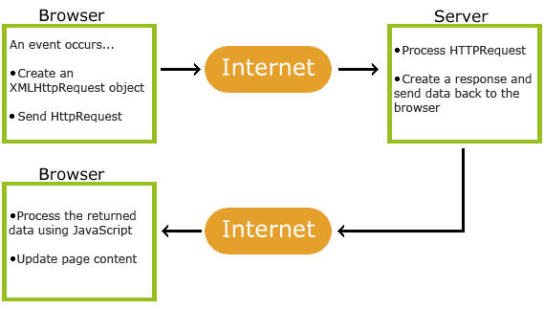
AJAX

Slide 4
XMLHttpRequest(): Example
myTutorials.txt
[
{
"display": "HTML Tutorial",
"url": "https://www.w3schools.com/html/default.asp"
},
{
"display": "CSS Tutorial",
"url": "https://www.w3schools.com/css/default.asp"
},
{
"display": "JavaScript Tutorial",
"url": "https://www.w3schools.com/js/default.asp"
},
{
"display": "jQuery Tutorial",
"url": "https://www.w3schools.com/jquery/default.asp"
}
]
Notes:
Ex 1 see next page

Slide 5
XMLHttpRequest(): Example
<div id="id01"></div> <script> xmlhttp = new XMLHttpRequest(); // create a XMLHttpRequest object url = "myTutorials.txt";
// create a function to be executed whenever the status of the object changes xmlhttp.onreadystatechange = function() { if (xmlhttp.readyState == 4 && xmlhttp.status == 200) { myArr = JSON.parse(xmlhttp.responseText); // return response myFunction(myArr); //callback function to handle the server response } } xmlhttp.open("GET", url, true); // initialise an asynchronous request to send to the server
// specify the HTTP request method, server location, and if asynchronous or synchronous xmlhttp.send(); // send the request to the server function myFunction(arr) { out = ""; for(i = 0; i < arr.length; i++) { out += '<a href="' + arr[i].url + '">' + arr[i].display + '</a><br>';
// <a href="http://www.w3schools.com">Visit W3Schools</a><br> } document.getElementById("id01").innerHTML = out;
} </script>
Notes:
Ex 1
4: request finished and response is ready
200: "OK“
The responseText property returns the server response as a text string.
Use JSON.parse() to convert text into a JavaScript object.
The HTTP request method to use, such as "GET", "POST", "PUT", "DELETE“
Syntax
XMLHttpRequest.open(method, url, async [opt], user [opt], password [opt])

Slide 6
GET or POST?
GET is simpler and faster than POST, but it can return cached data (there’s a workaround to it, though).
// add a unique ID to the URL xhttp.open("GET", "demo_get2.asp? t=" + Math.random(), true);
xhttp.send();
// send information with the GET method, add the information to the URL
xhttp.open("GET", "demo_get2.asp?fname=Henry&lname=Ford", true); xhttp.send();
Always use POST requests when:
A cached file is not an option (update a file or database on the server).
Sending a large amount of data to the server (POST has no size limitations).
Sending user input (which can contain unknown characters), POST is more robust and secure than GET.
xhttp.open("POST", "demo_post.asp", true); xhttp.send();

Slide 7
Asynchronous or Synchronous?
Communication between hosts can be synchronous or asynchronous.
Synchronous
All sending and receiving messages are synchronised to provide real-time communication.
When the sender sends a message to the receiver, the receiver receives this message and gives reply to the sender.
The sender will not send another message until it gets a reply from the receiver.
Asynchronous
There is no 2-way communication.
Messages are sent as soon as they are allowed to proceed.
Note:
Synchronous XMLHttpRequest (async = false) is not recommended because the JavaScript will stop executing until the server response is ready.
If the server is busy or slow, the application will hang or stop.
Notes:
Asynchronous: chatrooms and video conferences
Synchronous : emails and forums

Slide 8
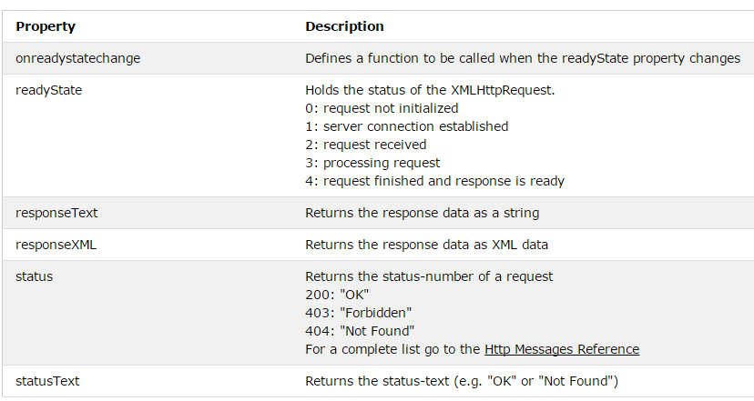
XMLHttpRequest Object Properties

Slide 9
Server Response
The readyState property holds the status of the XMLHttpRequest.
The onreadystatechange property defines a function to be executed when the readyState changes.
The status property and the statusText property holds the status of the XMLHttpRequest object.
The onreadystatechange function is called every time the readyState changes.
When readyState is 4 and status is 200, the response is ready.
The onreadystatechange event is triggered four times (1-4), one time for each change in the readyState.

Slide 10
JSON
JSON (JavaScript Object Notation) is a lightweight text-based open standard designed for human-readable data interchange.
extended from JavaScript
the file type for JSON files is ".json"
the MIME type for JSON text is "application/json“
language independent data interchange.

Slide 11
JSON Values
Strings // wrapped in "double quotes" // backslash used for escape characters
Numbers
Booleans
Objects Arrays
null

Slide 12
JSON Objects
{ "name":"John", "age":30, "car":null }
Objects are unordered containers of key/value pairs
Objects are wrapped in { }
, separates key/value pairs
: separates keys and values
Keys are strings
Values are JSON values
Values in a JSON object can be another JSON object.

Slide 13
JSON Objects
{
"name": "Jack Byrne",
"enrolled": true,
"birthday": {
"day": 10,
"month": "June",
"year": 1990,
},
"modules":[
"module1",
"module2"
]
}

Slide 14
Accessing JSON Objects
myObj = { "name":"John", "age":30, "car":null };
Access object values using dot (.) notation x = myObj.name; // returns ‘John’
Access object values using bracket ([]) notation x = myObj["name"];
Loop through object properties by using the for-in loop for (x in myObj) { document.getElementById("demo").innerHTML += myObj[x]; }
Modify object values using either the dot (.) notation or bracket ([]) notation myObj.car = "Mercedes"; myObj["car"] = "Mercedes";

Slide 15
JSON Array
"employees":[ {"firstName":"John", "lastName":"Doe"}, {"firstName":"Anna", "lastName":"Smith"}, {"firstName":"Peter","lastName":"Jones"} ]
Arrays are ordered sequences of values
Arrays are wrapped in []
, separates values
Just like JavaScript, a JSON array can contain multiple objects

Slide 16
JSON conversion
A common use of JSON is to exchange data to/from a web server.
When sending data to a web server, the data has to be a string.
JSON.stringify() – Used to convert JavaScript objects into strings var obj = { name: “John”, age: 30, city: “New York”}; var myJSON = JSON.stringify(obj);
json_encode() – Used to convert objects and arrays in PHP into JSON <?php $myObj->name = "John"; $myObj->age = 30; $myObj->city = "New York"; echo json_encode($myObj); // Returns{"name":"John","age":30,"city":"New York"} ?> <?php $myArr = array("John", "Mary", "Peter", "Sally"); echo json_encode($myArr); // returns ["John","Mary","Peter","Sally"] ?>

Slide 17
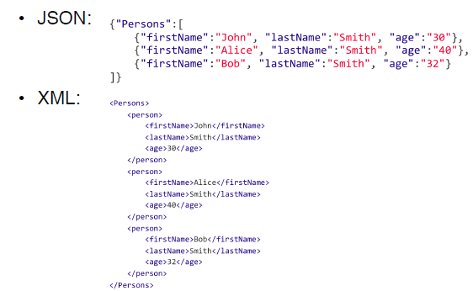
JSON vs XML

Slide 18
JSON vs XML
Both are plain text, can be parsed and used by multiple languages
Both are self describing (human readable)
Both are hierarchical
Both can be fetched with an XMLHttpRequest
XML has to be parsed with an XML parser to extract data
JSON can be parsed by a standard JavaScript function
JSON maps to JavaScript objects
JSON is potentially shorter, faster and easier to read and write, especially for AJAX applications

Slide 19
JSON vs XML
Using XML:
Fetch an XML document
Use the XML DOM to loop through the document
Extract values and store in variables
Using JSON:
Fetch a JSON string
JSON.parse the JSON string
Notes:
XML is much more difficult to parse than JSON.
myArr = JSON.parse(xmlhttp.responseText);

Slide 20
Parse JSON Text to JavaScript Object
JSON.parse(text) is supported by major browsers. For older ones, a compatible JavaScript library is available at JSON.org.
“text” String shall be in JSON syntax
You can then access the object’s properties with the dot notation:
var text = ‘{“name”:“Jack”, “school”: “DIT”}’;
var obj = JSON.parse(text);
obj.name
obj.school

Slide 21
AJAX and jQuery
Writing regular AJAX code can be a bit tricky, because different browsers have different syntax for AJAX implementation.
This means that you will have to write extra code to test for different browsers. Example:
var xhttp;
if (window.XMLHttpRequest) xhttp = new XMLHttpRequest(); else // code for IE6, IE5 xhttp = new ActiveXObject("Microsoft.XMLHTTP");
However, the jQuery team has taken care of this for us, so that we can write AJAX functionality with a single line of code.
Notes:
Old versions of Internet Explorer (IE5 and IE6) do not support the XMLHttpRequest object.

Slide 22
AJAX and jQuery: load
$(selector).load(URL, data, callback);
loads data from the server and puts the returned data into the selected element
the optional data parameter specifies a set of query string key/value pairs to send along with the request.
$("#div1").load("test.txt");
loads the content of the file "test.txt", and places it into the element with id “div1”

Slide 23
AJAX and jQuery: load
The optional callback parameter is the name of a function to be executed after the load() method is completed.
The callback function can have different parameters:
responseTxt - contains the resulting content if the call succeeds
statusTxt - contains the status of the call
xhr - contains the XMLHttpRequest object

Slide 24
AJAX and jQuery: load
<div id="div1"></div>
<script src="jquery-1.11.2.min.js"></script>
<script> $("#div1").load("myTutorials.txt", function(responseTxt, statusTxt, xhr){ if(statusTxt == "success") alert("External content loaded successfully!"); if(statusTxt == "error") alert("Error: " + xhr.status + ": " + xhr.statusText); });
</script>
Notes:
Ex 2

Slide 25
AJAX and jQuery: GET
$.get(URL, callback [opt]);
Retrieve data from a server using an AJAX HTTP GET request
$("button").click(function(){ $.get("example.php", function(data, status){ alert("Data: " + data + "\nStatus: " + status); });
});
URL The URL you wish to request
callback (optional)
The name of a function to be executed if the request succeeds.
The first callback parameter holds the content of the page requested.
The second callback parameter holds the status of the request.
example.php
<?php
echo 'test';
Notes:
Ex 3

Slide 26
AJAX and jQuery: POST
$.post(URL, data [opt], callback [opt]); Retrieve data from a server using an AJAX HTTP POST request
$("#btn1").click(function(){ $.post("demo_test_post.asp", { name: "Donald Duck", city: "Duckburg" }, function(data, status){ alert("Data: " + data + "\nStatus: " + status); }); });
URL The URL you wish to request
data (optional)
Specifies key/value parameters to send along with the request.
callback (optional)
The name of a function to be executed if the request succeeds.
The first callback parameter holds the content of the page requested.
The second callback parameter holds the status of the request.

Slide 27
AJAX and jQuery: XMLHttpRequest
All of jQuery's Ajax methods return a superset of the XMLHTTPRequest object.
It implements a Promise interface which allows jQuery's Ajax methods (e.g., $.get() and $.post()) to:
Chain multiple .done(), .fail(), and .always() callbacks on a single request
Assign these callbacks after the request may have completed. If the request is already complete, the callback is fired immediately.
Promises
Placeholders for the eventual result of an asynchronous operation.
Hold the value of any successful result or reason for failure.
Learn more at: https://api.jquery.com/jquery.get/.

Slide 28
AJAX and jQuery: XMLHttpRequest
$("button").click(function(){ xhr = $.get("example.php", function(){ alert("success"); })
.done(function() {
alert( "second success" );
})
.fail(function() {
alert( "error" );
})
.always(function() {
alert( “finished" );
});
// Set another completion function for the request above
xhr.always(function() {
alert( "second finished" );
});
});
Notes:
Ex 4

Slide 29
AJAX and jQuery: getJSON()
$(selector).getJSON(url, data [opt], success(data,status,xhr)) Loads JSON-encoded data from a server using a HTTP GET request
URL The URL you wish to request
data (optional)
Specifies data to be sent to the server.
success(data,status,xhr) (optional)
The name of a function to be executed if the request succeeds.
The first parameter holds the content of the data returned.
The second parameter contains a string containing the request status (e.g., "success", "notmodified", "error", "timeout", or "parsererror").
The third parameter contains the XMLHttpRequest object.
Learn more at: https://api.jquery.com/jquery.getjson/.

Slide 30
AJAX and jQuery: getJSON()
$(selector).getJSON(url, data, success(data,status,xhr)) Loads JSON-encoded data from a server using a HTTP GET request
$(“button").click(function(){ $.getJSON(“test.json", function(result){ $.each(result, function(key, value){ $("div"). append("param: " + key + " data: " + value+ "<br>"); }); }); });
test.json
{
"one": "Little Bo Beep",
"two": "Mary has a little lamb",
"three": "Hey Diddle Diddle"
}
Notes:
Ex 5

Slide 31
AJAX and jQuery: Retrieve data from MySQL using PHP
<!DOCTYPE html>
<html lang="en">
<body>
<input type="text" id="guest"><br>
<div></div>
<script src="jquery-1.11.2.min.js"></script>
<script src="getGuests.js"></script>
</body>
</html>
index.php
Notes:
Ex 6 see next page

Slide 32
AJAX and jQuery: Retrieve data from MySQL using PHP
$(function () {
$('#guest').on('blur', function (e) { // Define function event On Button click
var queryGuest = 'id=' + $('#guest').val(); // prepare query
// GET JSON array with the specified guest record
$.getJSON('guests.php?' + queryGuest)
.done(function (data) { // GET is sucessful
$.each(data, function (index, value) {
if (typeof value === "string")
{
alert(data);
}
else
{
$("div"). append("Id: " + value.id + " Name: " + value.firstname + ' ' + value.lastname + "<br>");
}
});
}).fail(function (xhr, textStatus, errorThrown) { // GET failed
alert("An error occured: " + textStatus + ' ' + errorThrown);
});
});
})
getGuests.js
Notes:
Ex 6 see next page

Slide 33
AJAX and jQuery: Retrieve data from MySQL using PHP
<?php
try
{
$pdo = new PDO('mysql:host=localhost;dbname=dbName', ‘user', ‘password');
$pdo->setAttribute(PDO::ATTR_ERRMODE, PDO::ERRMODE_EXCEPTION);
$pdo->exec('SET NAMES "utf8"');
}
catch(PDOException $e)
{
echo json_encode(['Unable to connect to the database server']);
exit;
}
if(isset($_GET['id']))
{
$guest = intval($_GET['id']);
try
{
$sql = 'SELECT id, firstname, lastname
FROM myguests
WHERE id = :guest';
$s = $pdo->prepare($sql);
$s->bindValue(':guest', $guest);
$s->execute();
}
catch(PDOException $e)
{
echo json_encode(['Could not get guest records']);
exit;
}
$rows = $s->fetchAll();
echo json_encode($rows);
};
guests.php
Notes:
Ex 6

Slide 34
AJAX and jQuery: $.ajax
The $.ajax() method:
Gives greater control over Ajax requests.
Has over 30 different settings that can be used.
Is the method used by all other jQuery Ajax shorthand methods.
Settings
type: take values GET or POST.
url: The URL to be requested.
data: The data that is being sent to the server with the request.
success: A function that runs if the request completes successfully ( as per the .done() method).
error: A function that runs if there is an error with the request ( as per the .fail() method).
beforeSend: A function that is run before the request starts.
complete: A function that runs after success / error events (as per the .always() method).
timeout: The number of milliseconds to wait before the event should fail.

Slide 35
AJAX and jQuery: $.ajax
$("button").click(function(){
$.ajax({
url: "demo.txt",
timeout: 2000,
beforeSend: function() {
$("body").append('<div id="load">Loading</div>')
},
success: function(result) { $("body").append('<div id="success"></div>');
$("#success").html(result).fadeIn(4000);
},
complete: function() {
setTimeout(function(){
$("#load").remove()
}, 1000);
}
});
});
Learn more at: https://api.jquery.com/jquery.ajax/.

